Slide 1
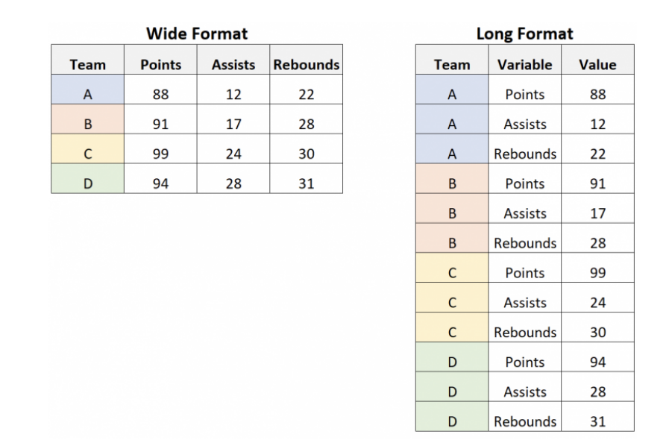
Longer vs. Wider Data

Slide 2
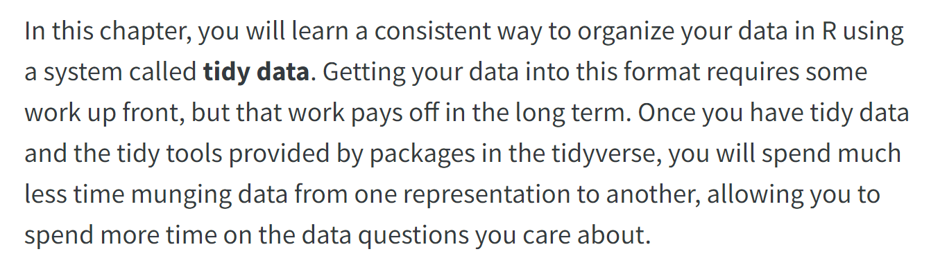

Slide 3
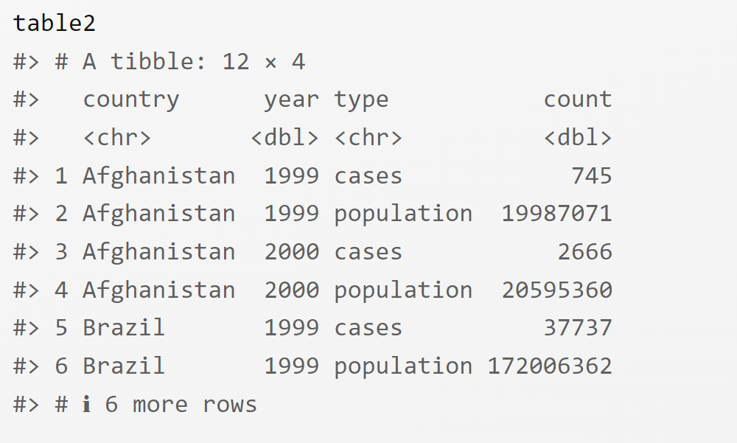
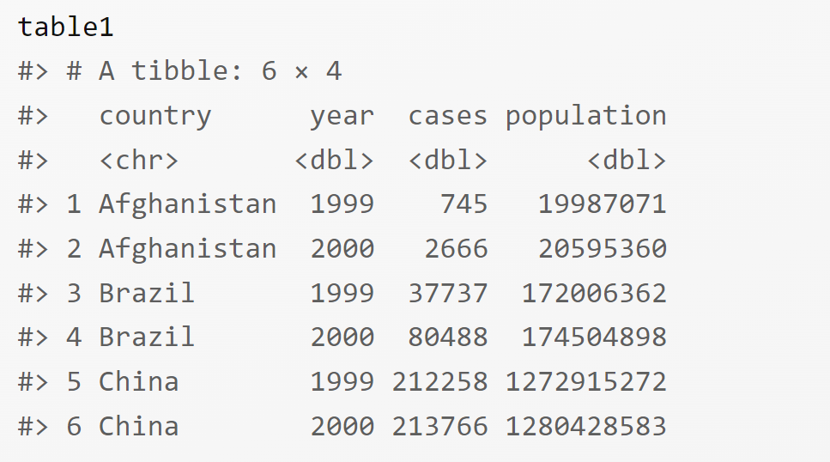
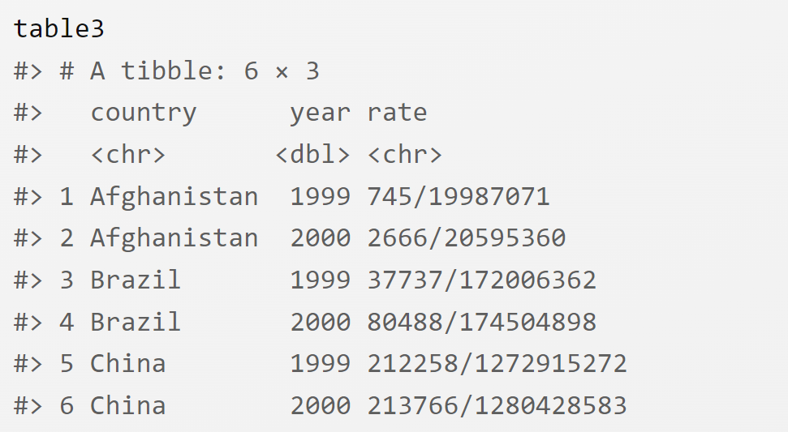

Slide 4
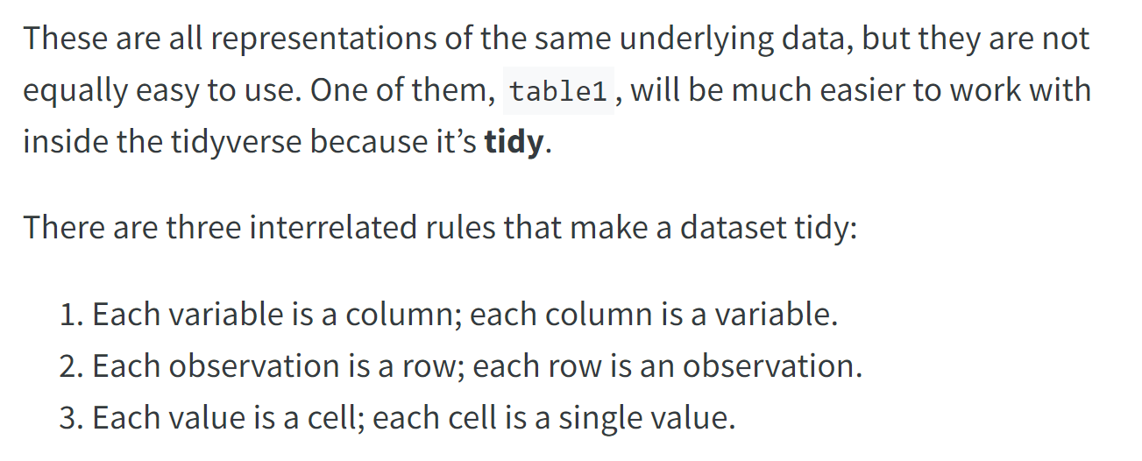

Slide 5
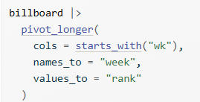
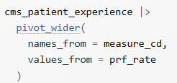

Slide 6

"This data is now tidy…" -Wickham and Grolemund

Slide 8
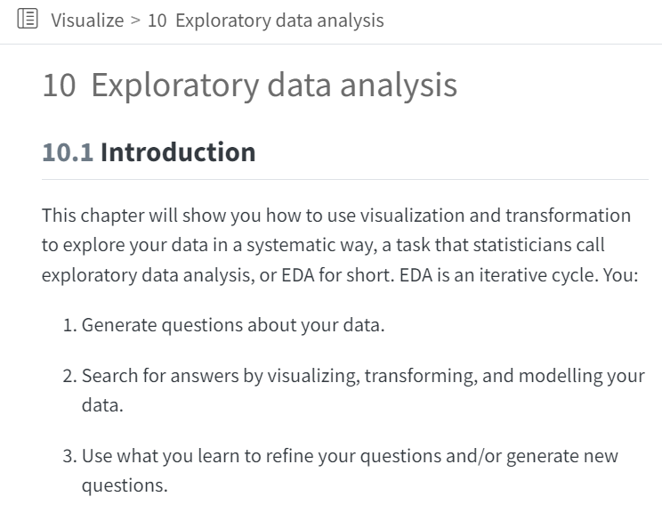
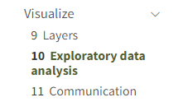

Slide 9
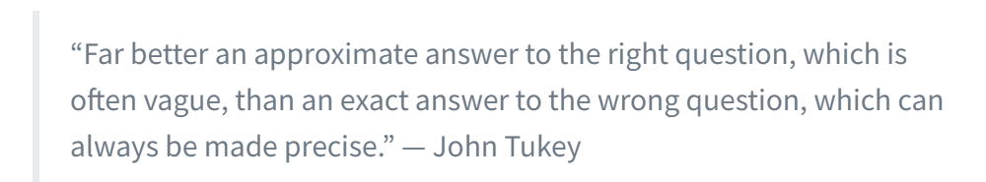

Slide 10
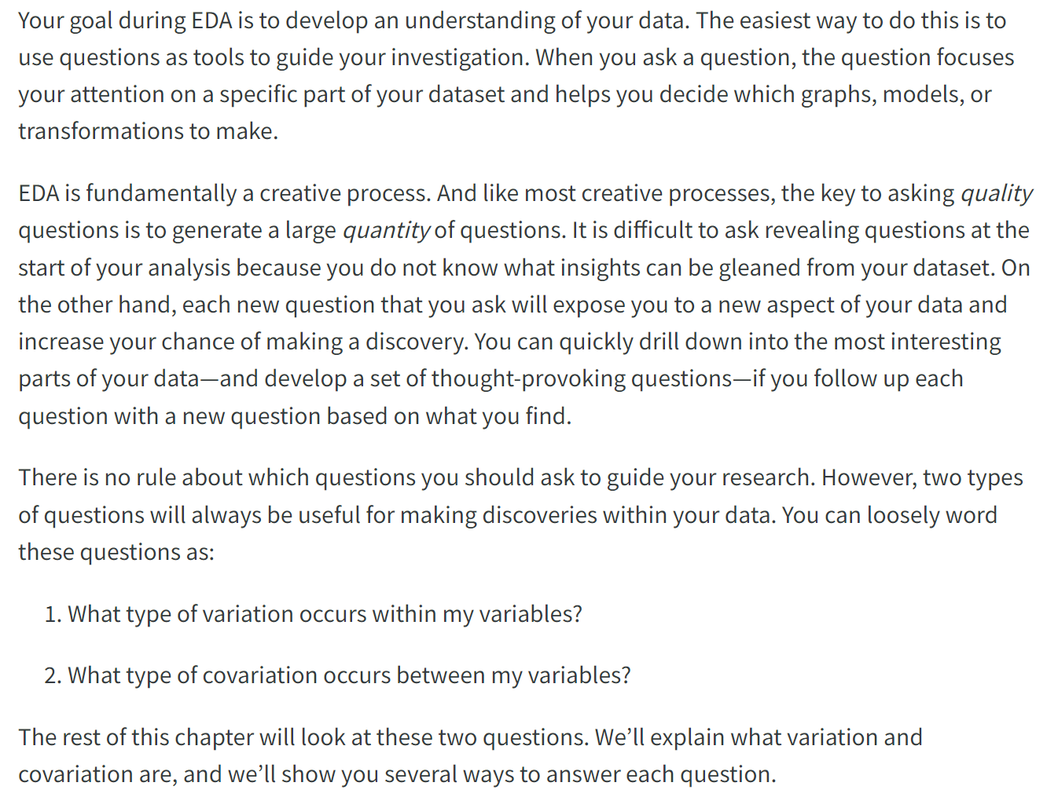

Slide 11
library(tidyverse)
ggplot(diamonds, aes(x=carat,y=price)) +
geom_point()

Slide 12
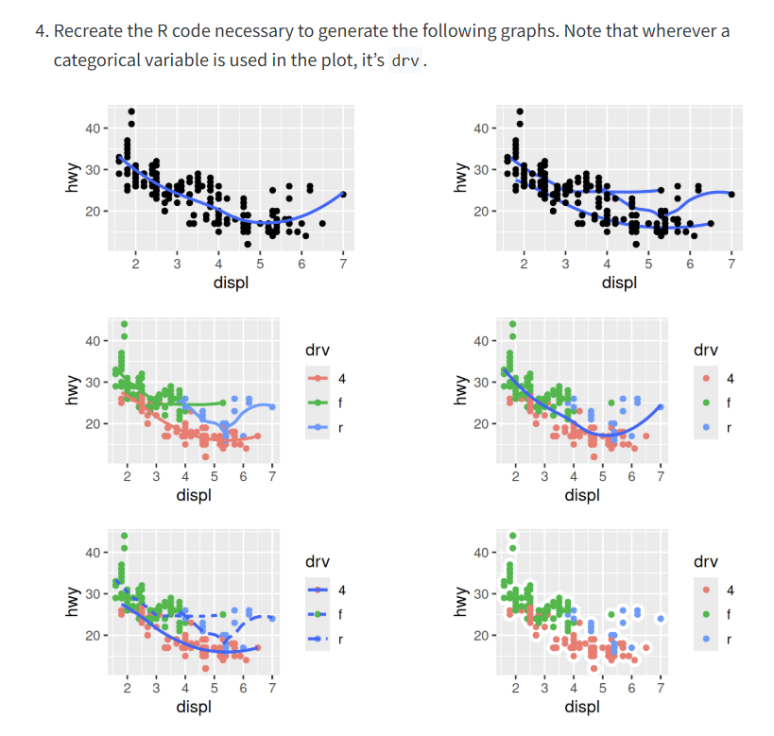

Slide 13
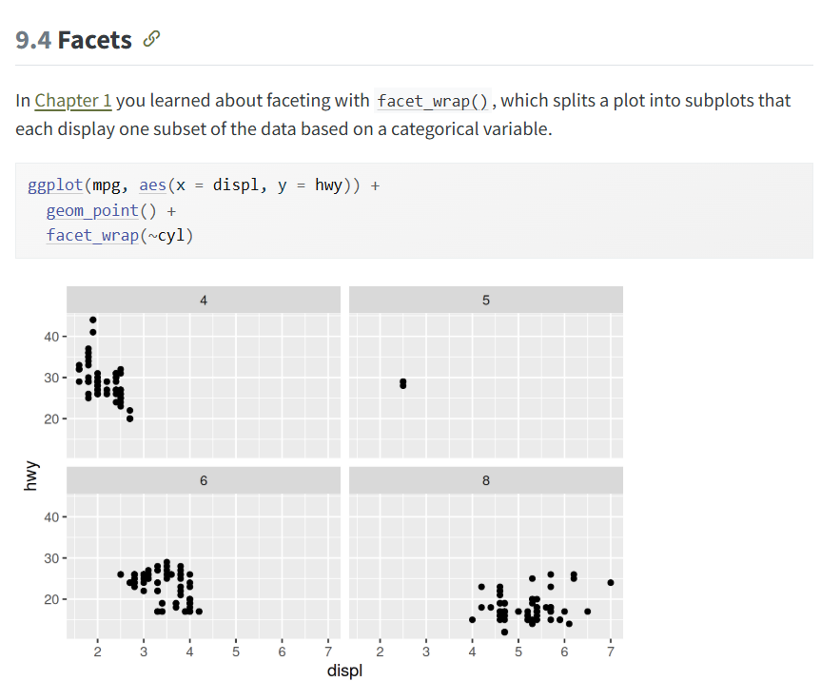

Slide 14
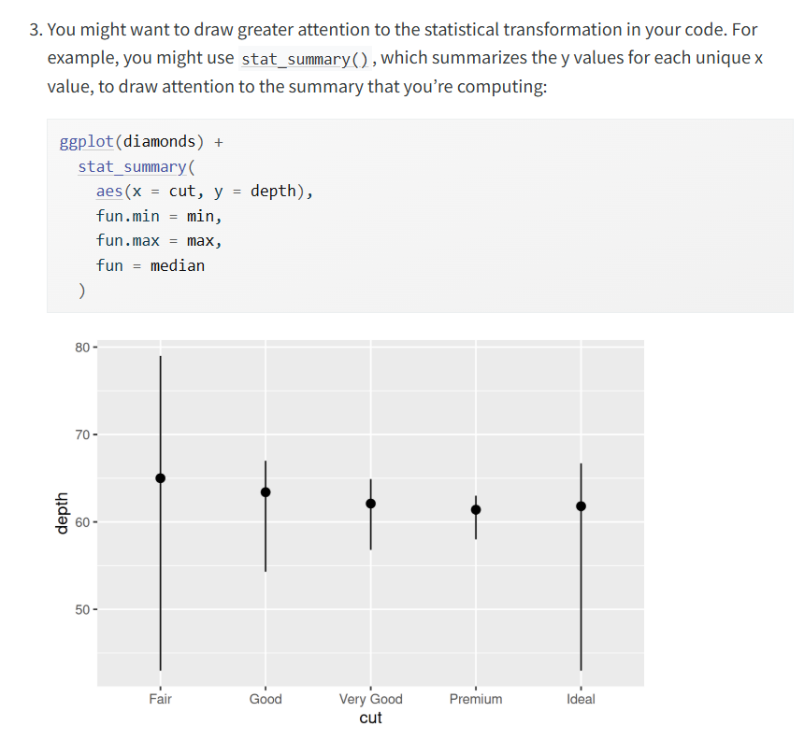

Slide 15
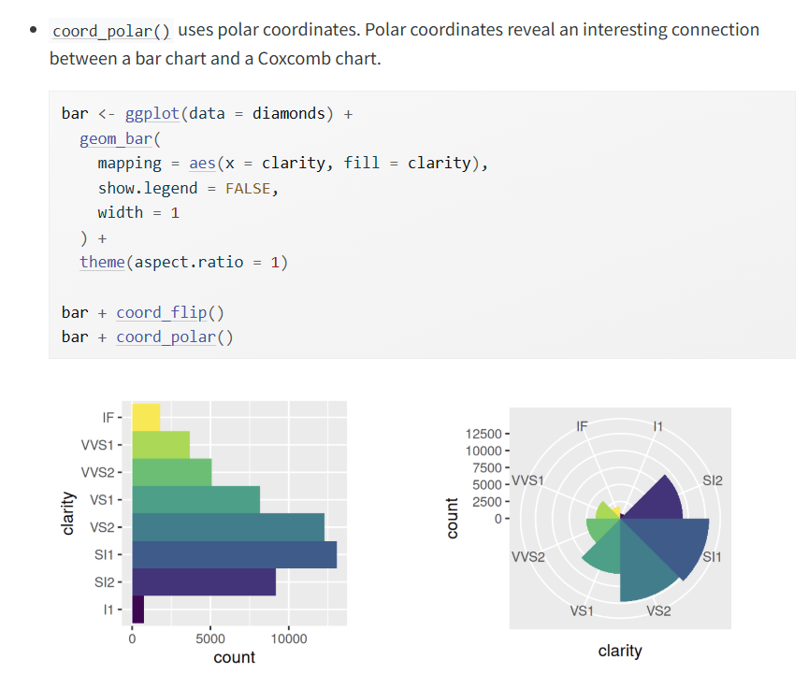

Slide 16
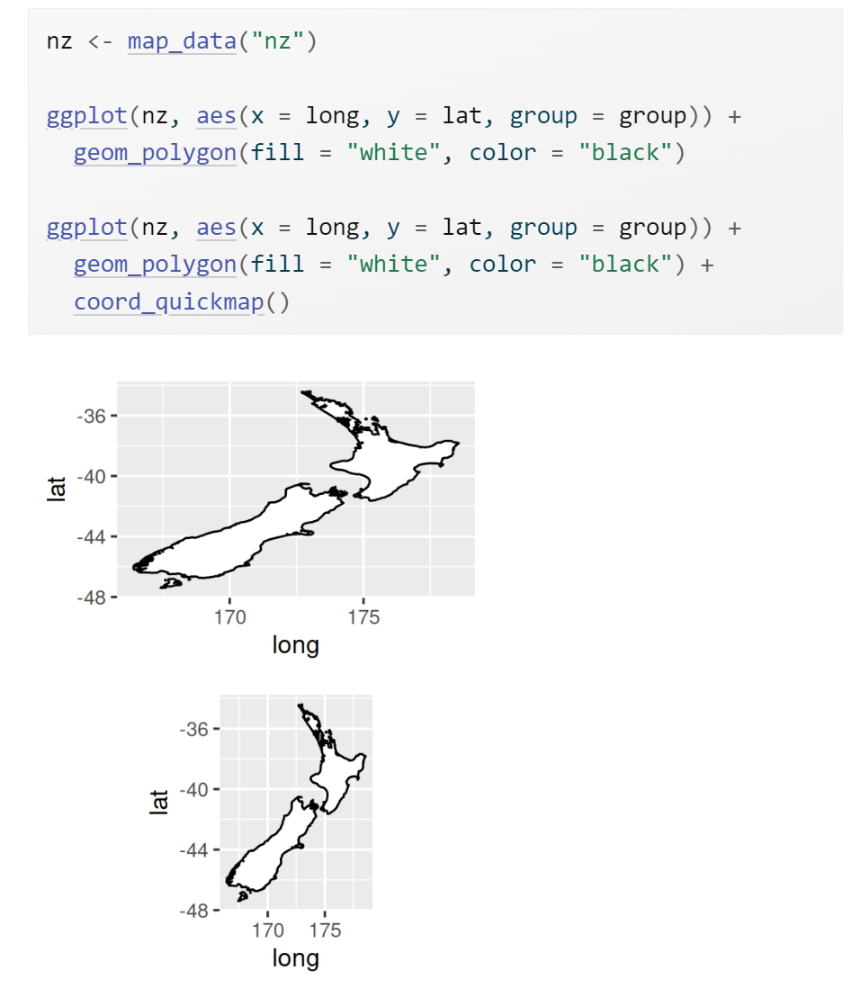

Slide 17
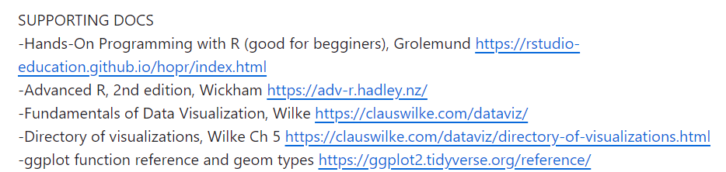

Slide 18
Walk through and create each plot shown in Ch 10 Exploratory Data Analysis. Think about and discuss these questions.
1. What question(s) does each plot address?
2. How would you improve the plot to address the question, or are you reasonably satisfied by it?
3. What additional questions does each plot provoke in your mind?
4. How would you address any further questions with provoked by the visualization?
5. If time permits, repeat 1 through 4 for the visualizations in Ch 9.

Slide 19
Walk through and create several of the visualizations summarized at
https://ggplot2.tidyverse.org/reference/
Think about and discuss these questions.
1. Are there any geoms that you've never used before? Which ones?
2. Create a plot using a new geom. What is satisfying or not satisfying about the geom? Repeat for additional geoms.
3. Think about your own research or research of peers in terms of a specific dataset, its variables, questions about the data, and hypotheses. Are there any geoms that seem particularly useful for addressing a given question or hypothesis?

Slide 21
Dates
Load the samples dataset and convert the datecollect column into an unambiguous format with 2024-03-14.

Slide 22
Functions
What is a function?
When and why are functions useful?
What are some common challenges encountered in developing and using functions?

Slide 23
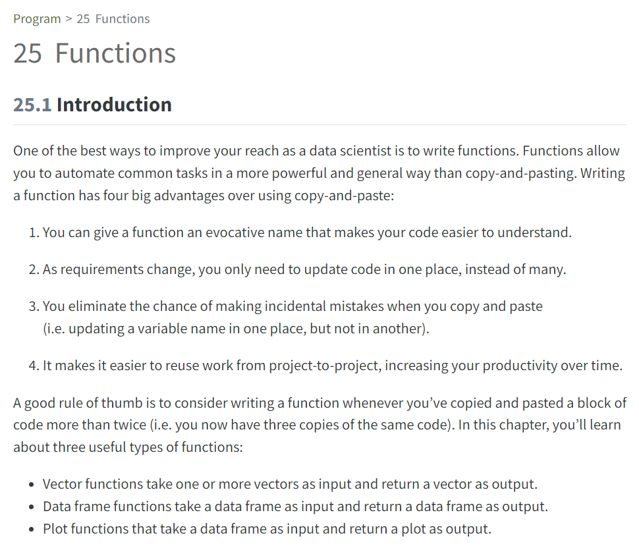

Slide 25
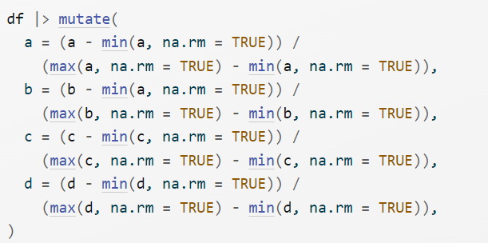

Slide 26
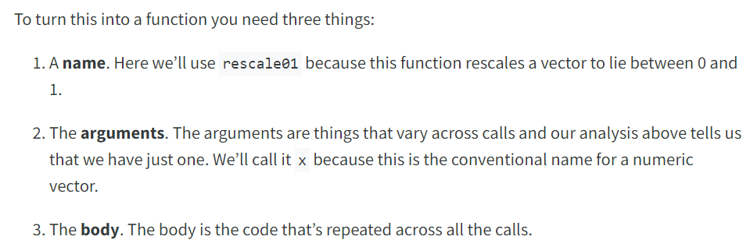

Slide 27
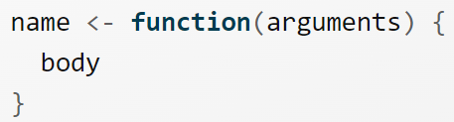

Slide 28
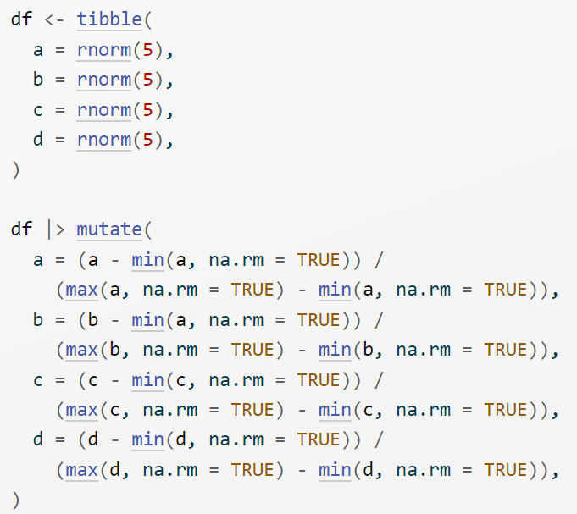

Slide 29
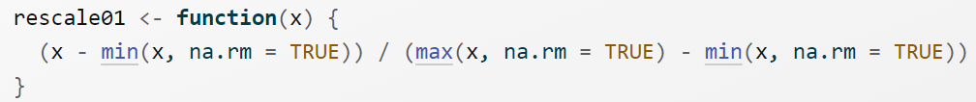

Slide 30
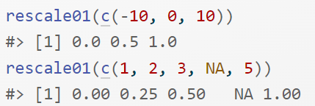

Slide 31
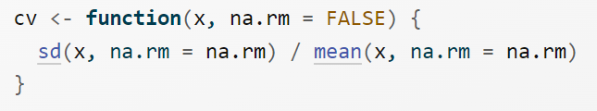

Slide 32
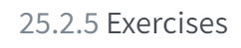

Slide 33
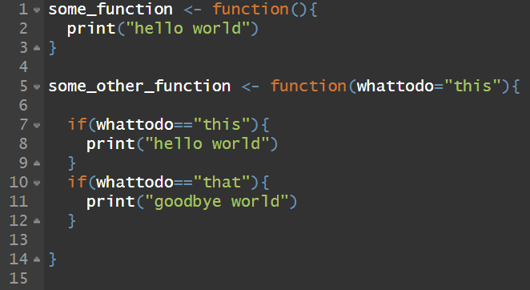

Slide 34
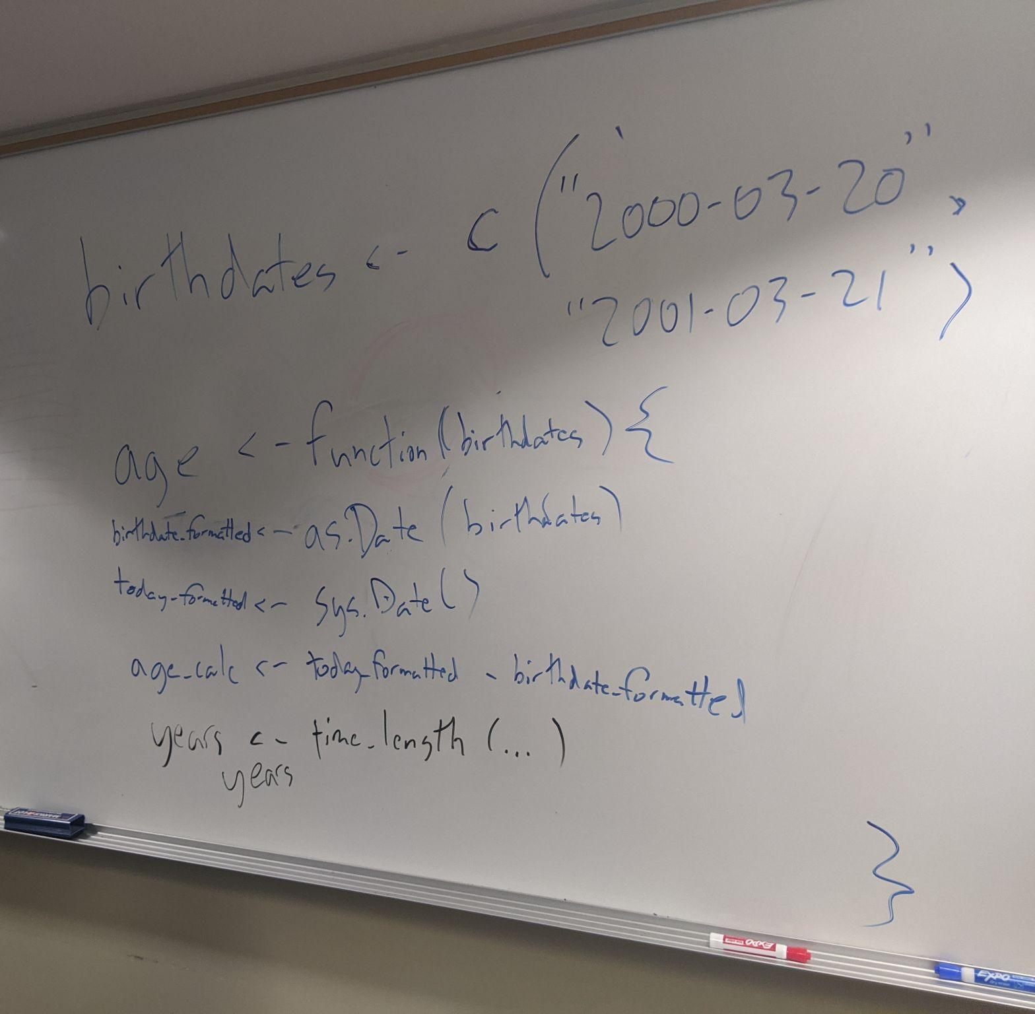

Slide 35
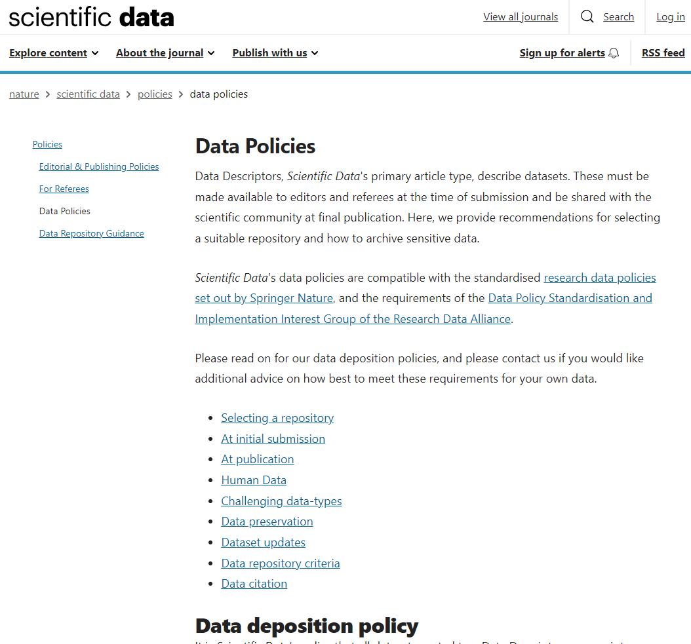

Slide 36
Questions
What's a data policy?
What does "open science" mean?
What questions does the data policy of Scientific Data generate? (in your mind, for the scientific community, practical or philosophical, ethical, etc.)

Slide 37
Questions
What questions does the data policy of Scientific Data generate? (in your mind, for the scientific community, practical or philosophical, ethical, etc.)

Slide 39
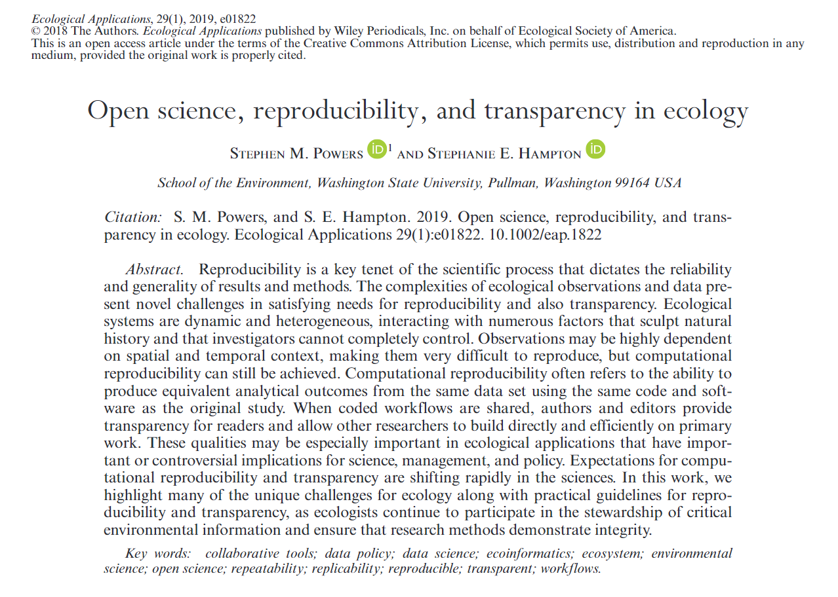

Slide 40
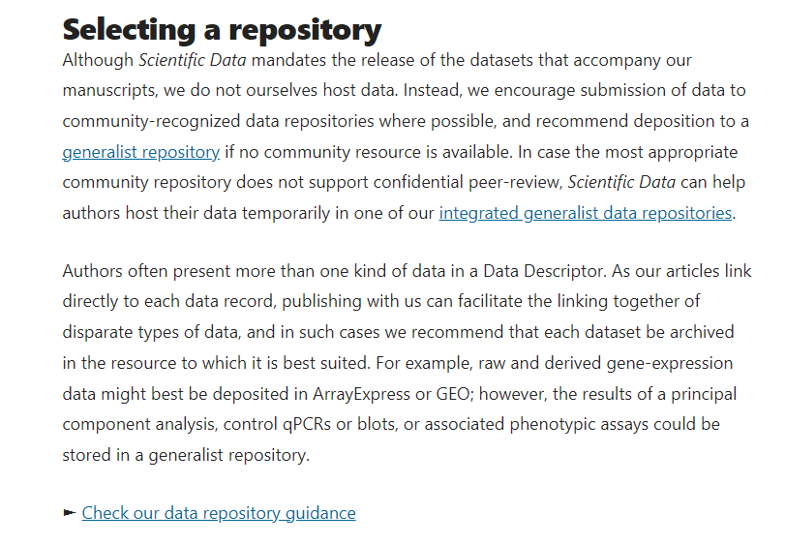
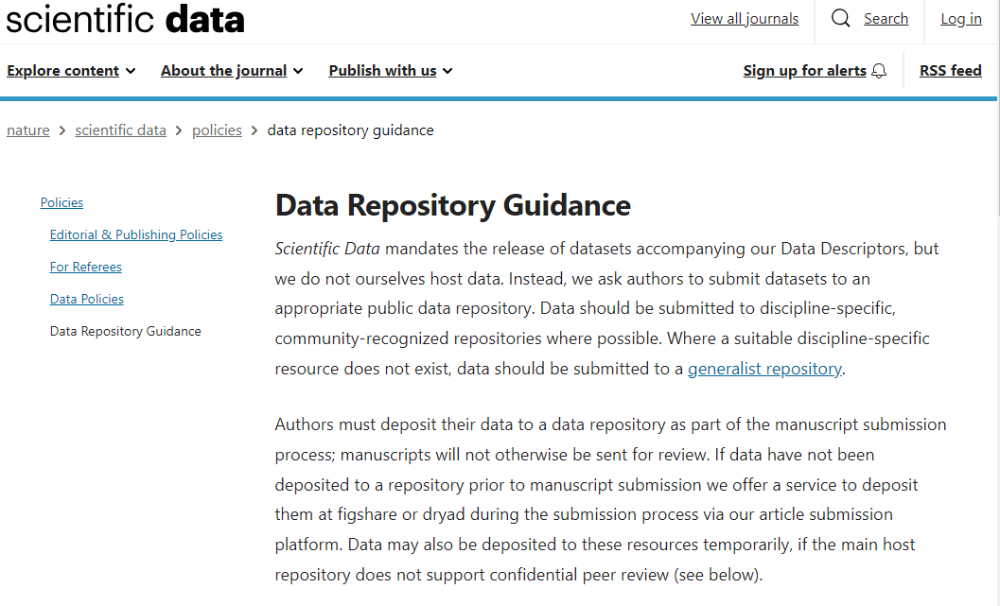

Slide 41
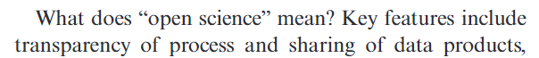

Slide 42
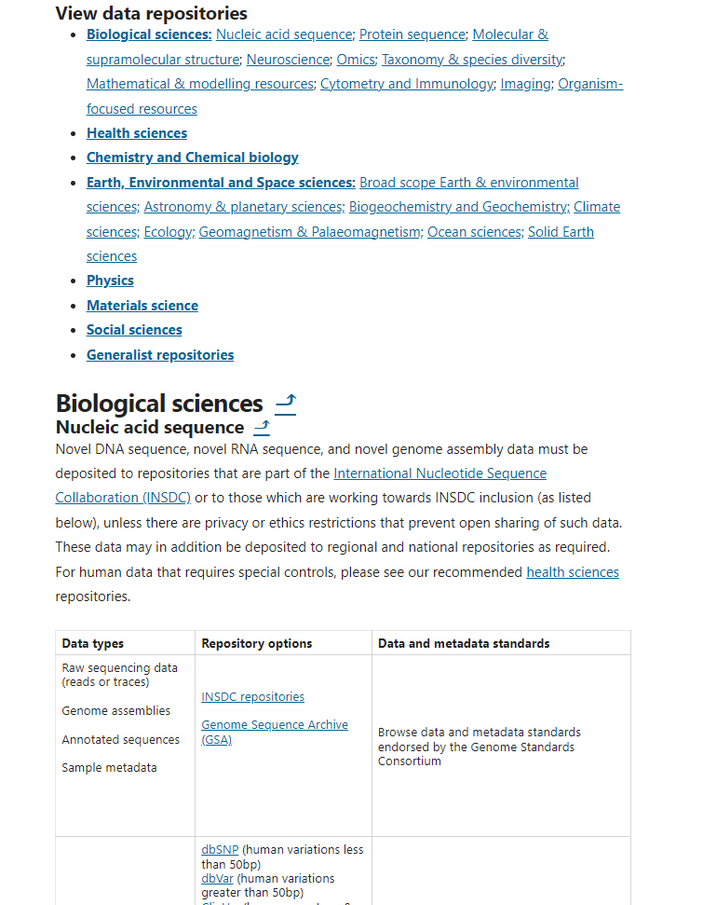
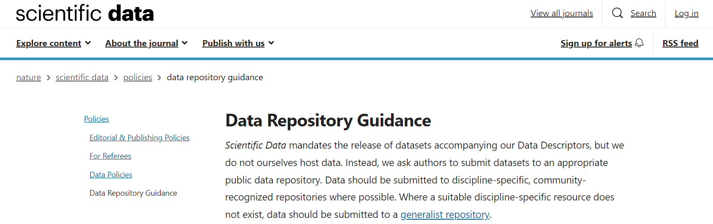
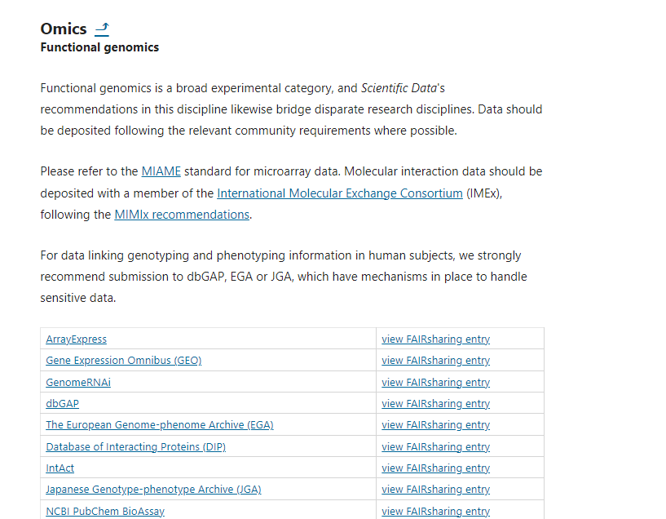

Slide 43
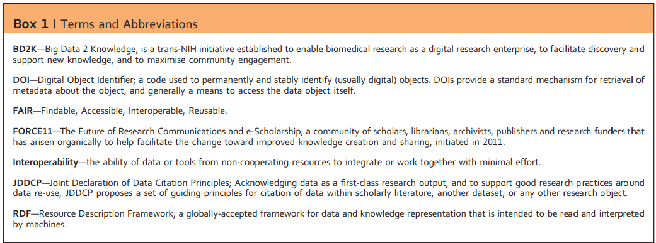
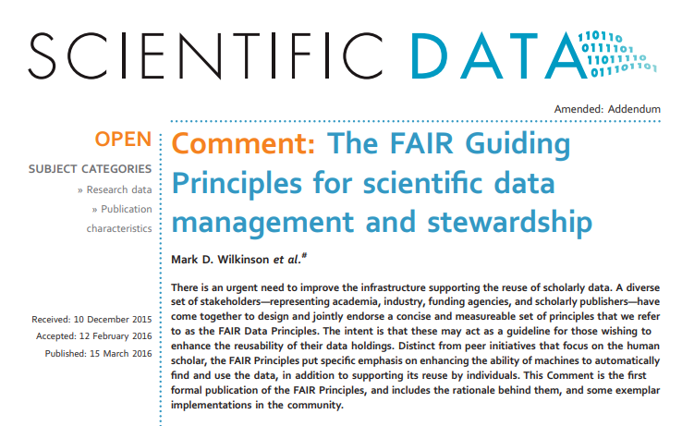
FAIR data principles,
and the data life cycle

Slide 44
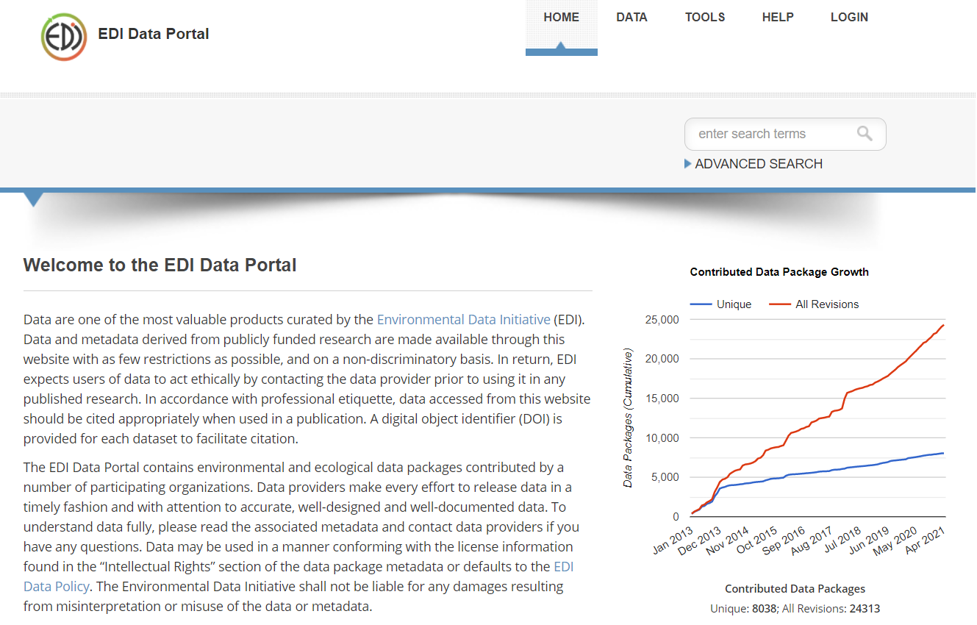
https://portal.edirepository.org/nis/home.jsp

